Slide 1
Statistics 367-1-4361 PyMC and Sampling
Opher Donchin

Slide 2
Where we came from and where we are going
Lecture 1
What is data and why can’t it reveal truth
How can probability represent our knowledge
Lecture 2
Using Bayes rule to update models
Finding the posterior with grid computation
Lecture 3
Computing the posterior with sampling
Estimating the true value of the parameter
Expressing our uncertainty in that estimate
Data
Models
Sampling
MCMC

Slide 3
3.1 Graphical models
Representing models using graphs

Slide 4
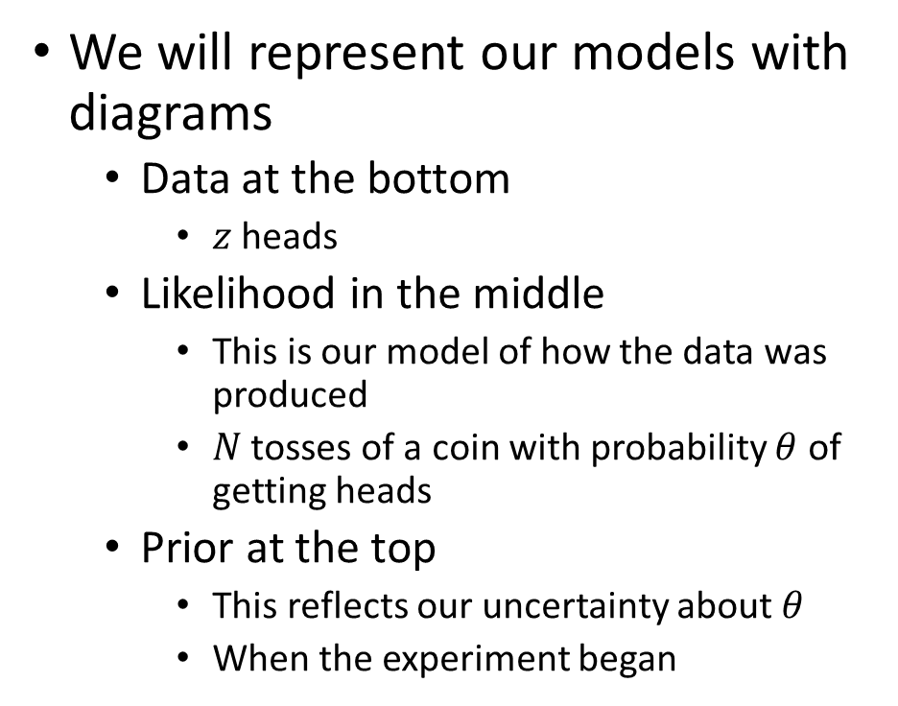
Representing models using graphs
We will represent our models with diagrams
Data at the bottom
$z$ heads
Likelihood in the middle
This is our model of how the data was produced
$N$ tosses of a coin with probability $θ$ of getting heads
Prior at the top
This reflects our uncertainty about $θ$
When the experiment began
Prior
Likelihood
Data

Slide 5
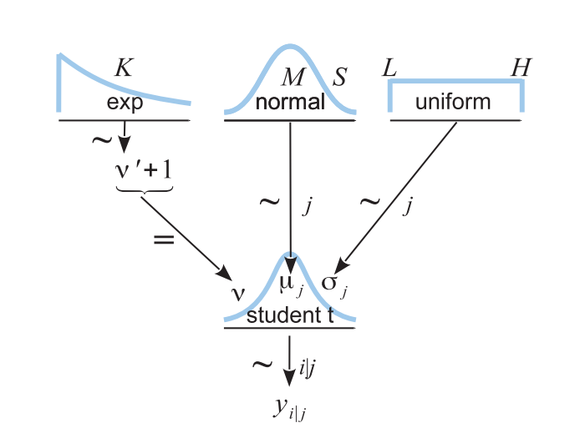
Rules for graphical models
Nodes
Data
Distributions
With parameters
Equation
Arrows
From distributions or equations
Prior
To parameter
Likelihood
To data

Slide 6
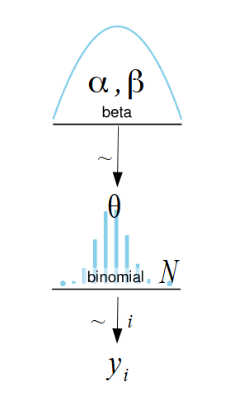
Different styles for graphical models
There is no one correct style
Classic DAG
Plate notation
Kruschke Diagrams

Slide 7
3.2 Probabilistic programming languages
PPLs can be used to describe models

Slide 8
Why Bayesian inference became computational
1930-1950s: Purely analytical and mathematical approaches
1950-1980s: Limitations of the mathematical approaches
Early 1990s: Development of MCMC algorithms promises approximate solutions
mid 1990s-early 2000s: Early probabilistic programming languages PPLs like BUGS make MCMC available without programming the whole algorithm
2000s-2010s: New generations of PPLs introduced
2020s: Innovation beyond PPLs

Slide 9
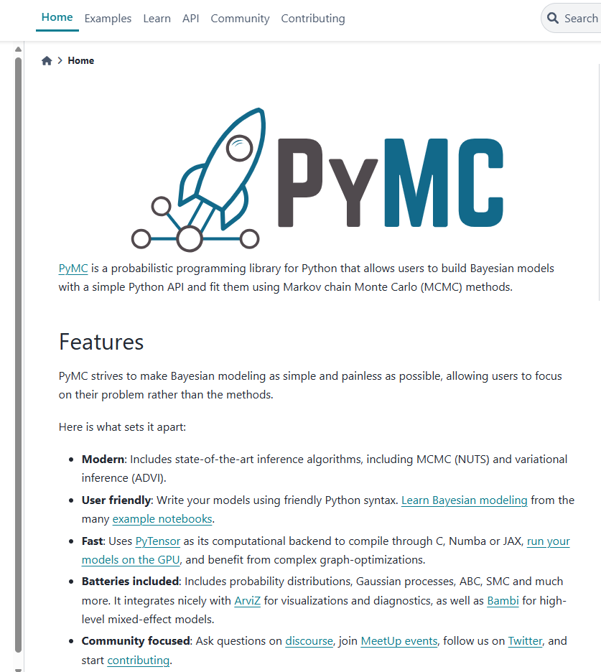
PyMC: a PPL for Python

Slide 10
From probabilistic model to graphical model
Equations
Graphical model
PyMC (a PPL)
with pm.Model() as our_first_model:
θ = pm.Beta('θ', alpha=1., beta=1.)
y = pm.Bernoulli('y', p=θ, observed=data)
Three representations of the same idea

Slide 11
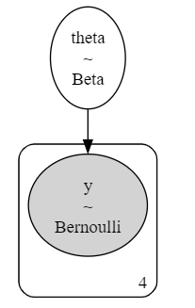
The PyMC graphical visualizer
Visualize any PyMC model
Shows: dimensionality, distributions, and dependencies
pm.model_to_graphviz(our_first_model)

Slide 12
3.3 Sampling
Using sampling to approximate the posterior distribution

Slide 13
Why sample?
Analytic solutions not always available?
Must choose a likelihood with a conjugate prior
Must have a conjugate prior that fits
Grid solution often too limited
Works great for 1 parameter
Becomes quickly untenable for more than 2 or 3 parameters
We’ll learn it on one parameter, just to make things simple

Slide 14
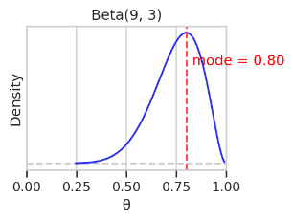
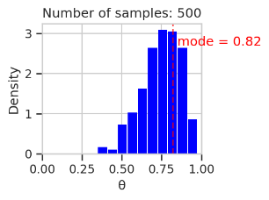
Sampling: 500 draws
We can sample in order to characterize a distribution

Slide 15
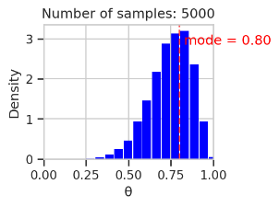
Sampling: 5,000 draws
We can sample in order to characterize a distribution
Larger samples give more accuracy

Slide 16
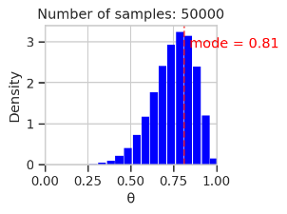
Sampling: 50,000 draws
We can sample in order to characterize a distribution
Larger samples give more accuracy
With a sample we can estimate parameters

Slide 17
Sampling and PPL
A PPL will have at least two parts:
Model building
Sampling
with pm.Model() as our_first_model:
θ = pm.Beta('θ', alpha=1., beta=1.)
y = pm.Bernoulli('y', p=θ, observed=data)
idata = pm.sample(1000, model=our_first _model, random_seed=4591)

Slide 18
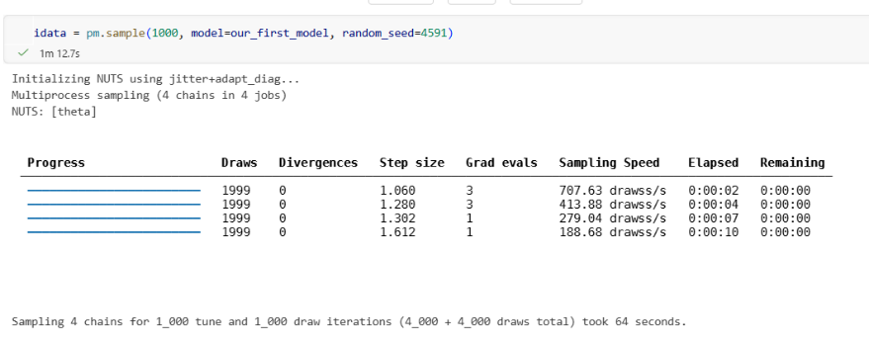
What happens when we call pm.sample()?
Pick a sampling algorithm
Initialize
Run multiple chains

Slide 19
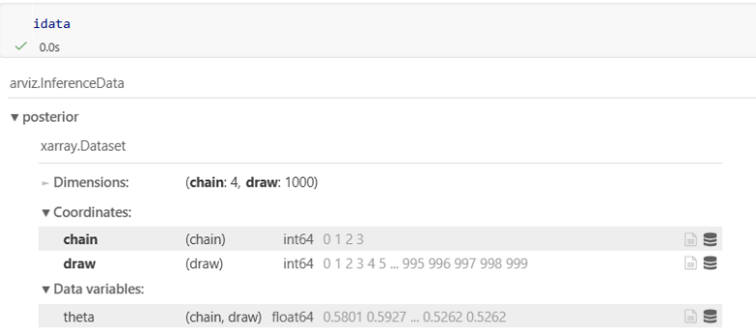
posterior has the samples
One variable: θ
Two dimensions: chain and draw
4,000 draws
A draw is one set of parameters sampled from the posterior distribution
A chain is a series of draws

Slide 20
Draws and samples
“Samples” is an overloaded term
The data is a sample from the population
We take samples from the posterior distribution of the parameters
To avoid confusion:
Use sample when talking about data collection
Use draw when talking about Bayesian sampling
We will not always remember to be consistent
Sorry!

Slide 21
3.4 Plotting the posterior distribution
Arviz tools for visualizing the posterior

Slide 22
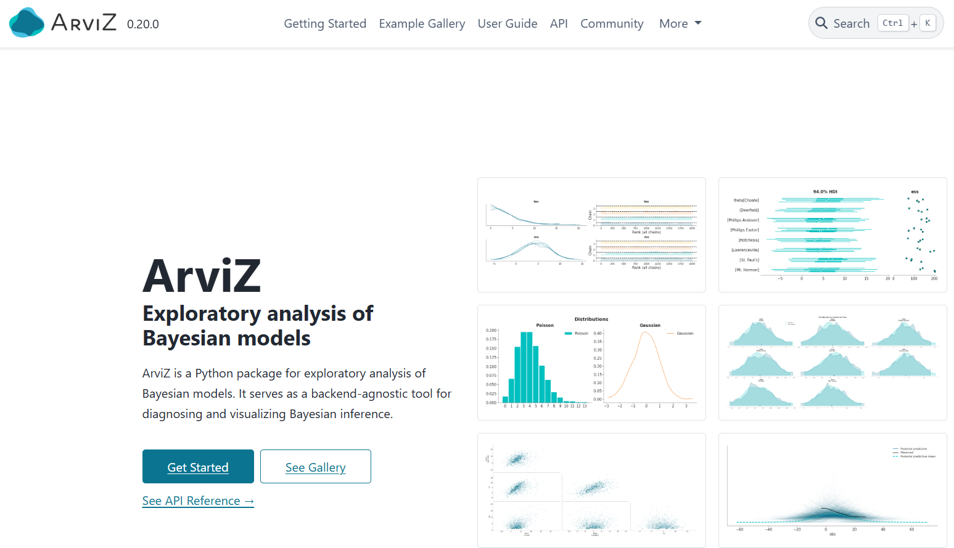
Arviz: Analyzing Bayesian data
https://python.arviz.org/en/stable/

Slide 23
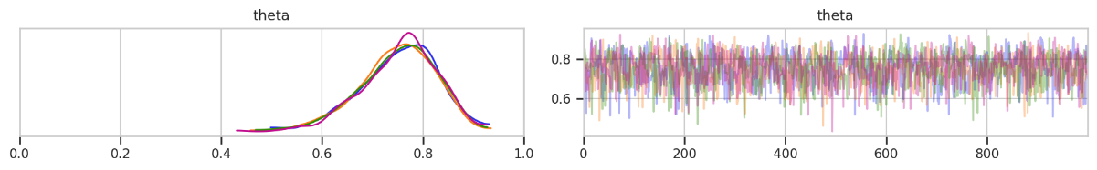
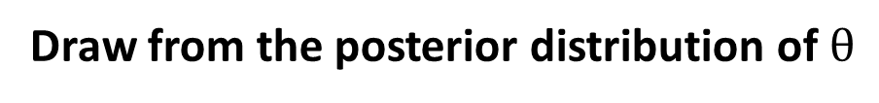
Sampling the posterior for fake data
Draw from the posterior distribution of $θ$
idata = pm.sample(1000, model=our_first _model, random_seed=4591)
Plot the draws
az.plot_trace(idata, chain_prop='color')

Slide 24
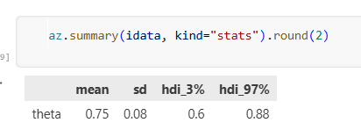
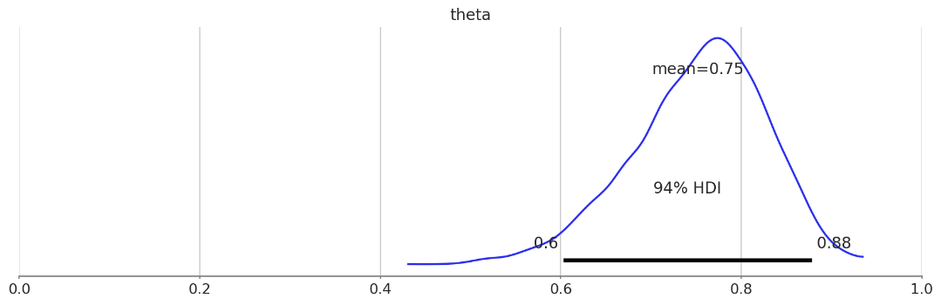
Arviz summary of the posterior
az.plot_posterior(idata, figsize=(12, 4));

Slide 25
3.5 Estimation
The best guess for the parameter

Slide 26
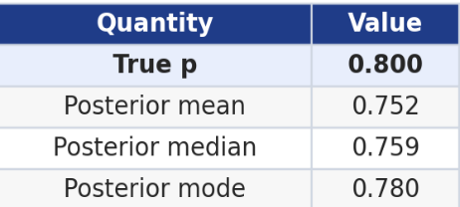
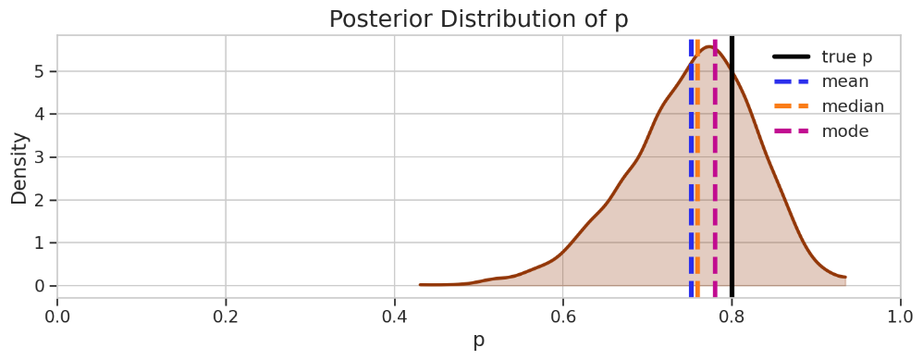
Different estimates of the true value

Slide 27
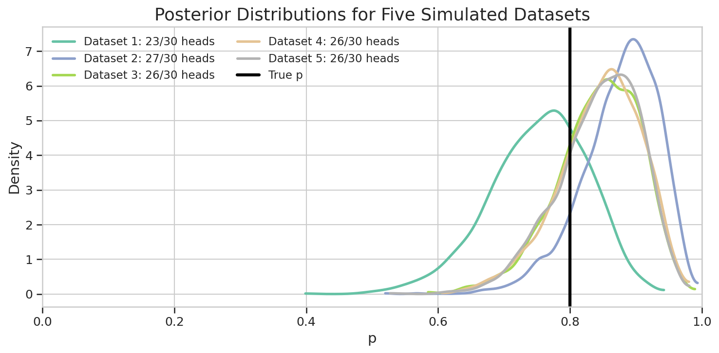
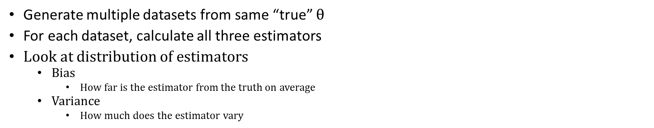
To understand estimators, use simulated data
Generate multiple datasets from same “true” $θ$
For each dataset, calculate all three estimators
Look at distribution of estimators
Bias
How far is the estimator from the truth on average
Variance
How much does the estimator vary

Slide 28
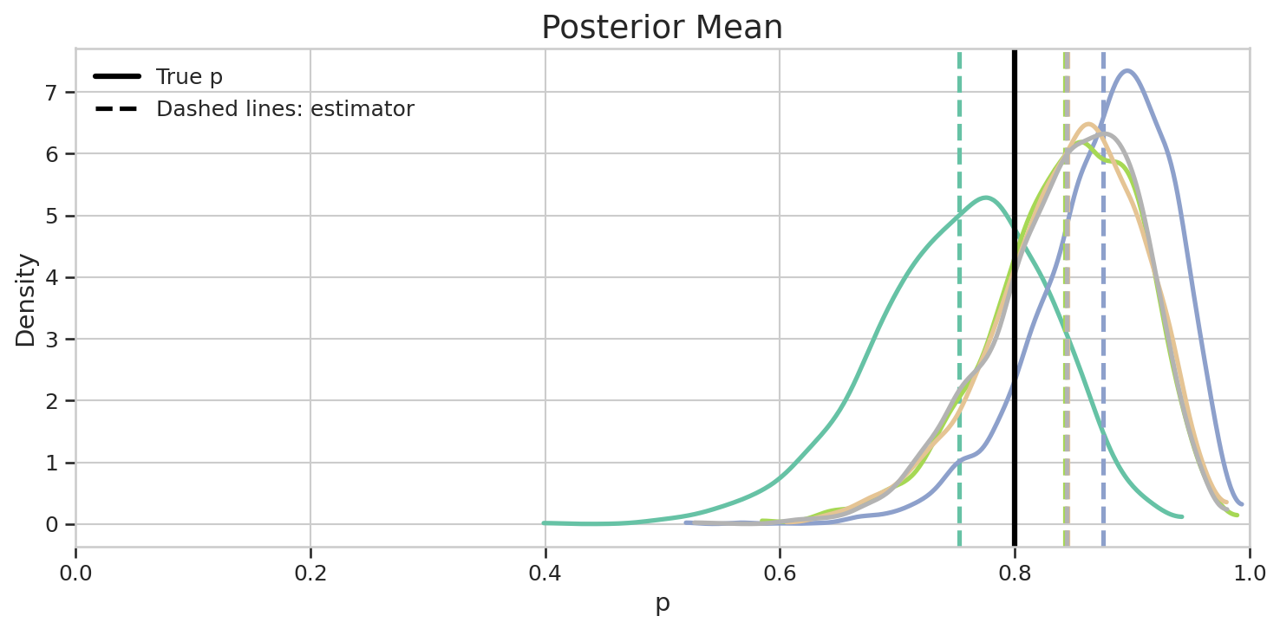
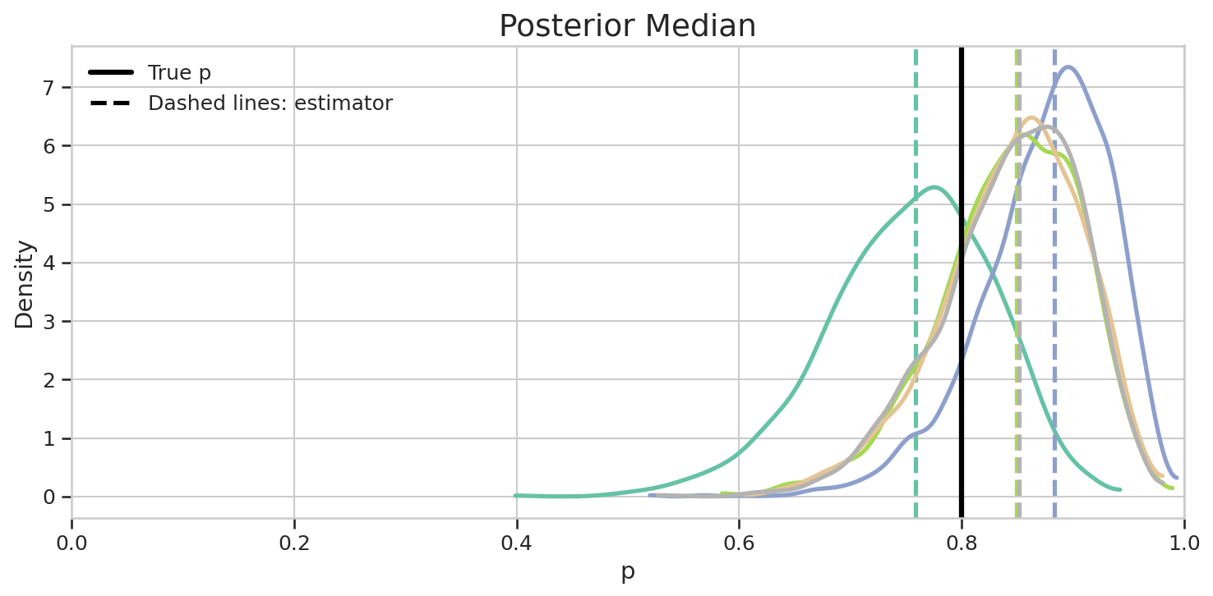
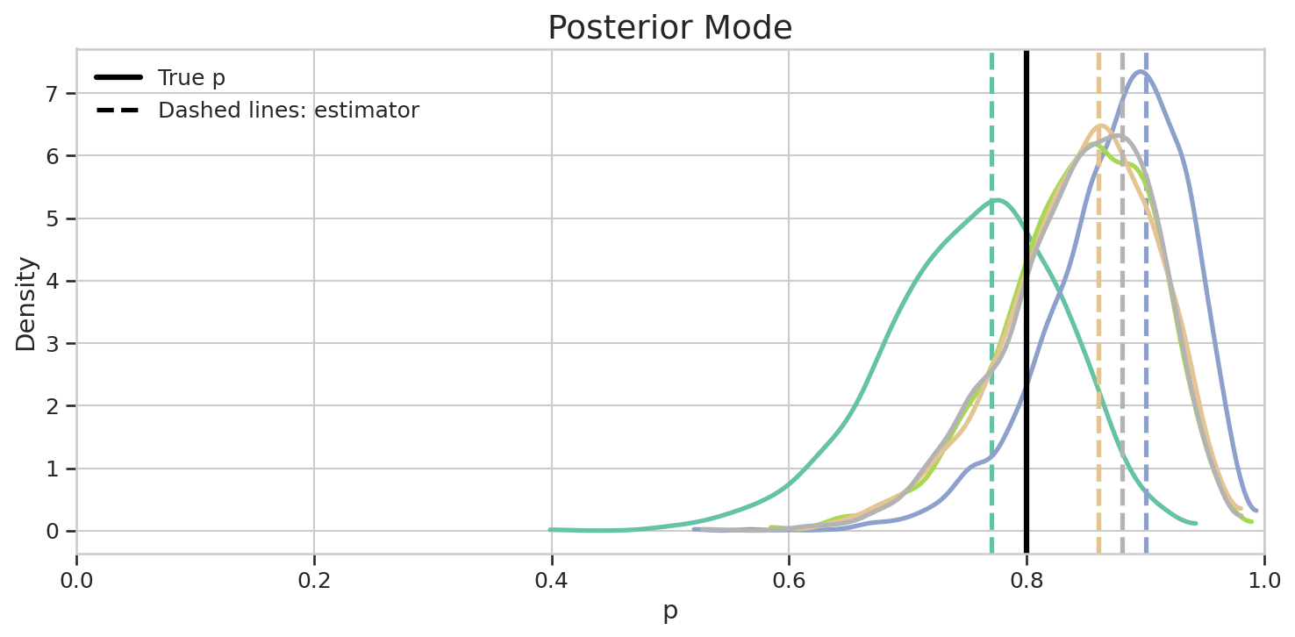
Calculating each estimator on different samples

Slide 29
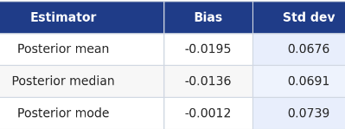
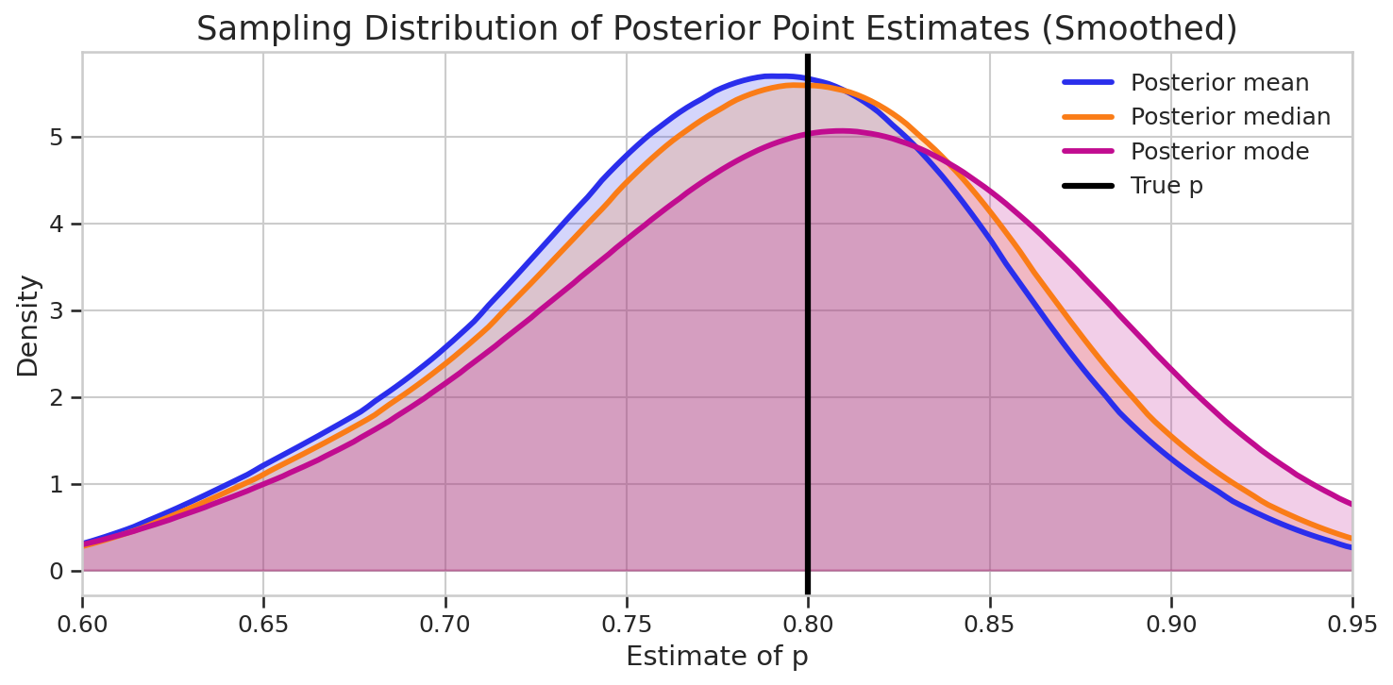
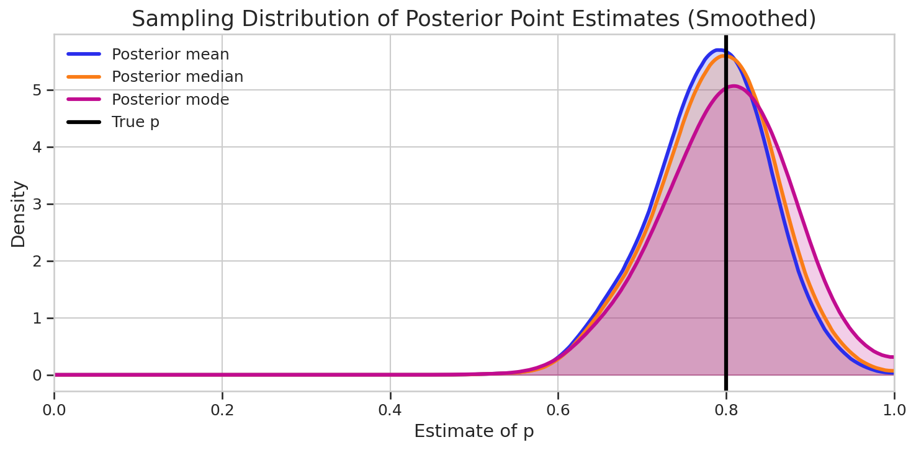
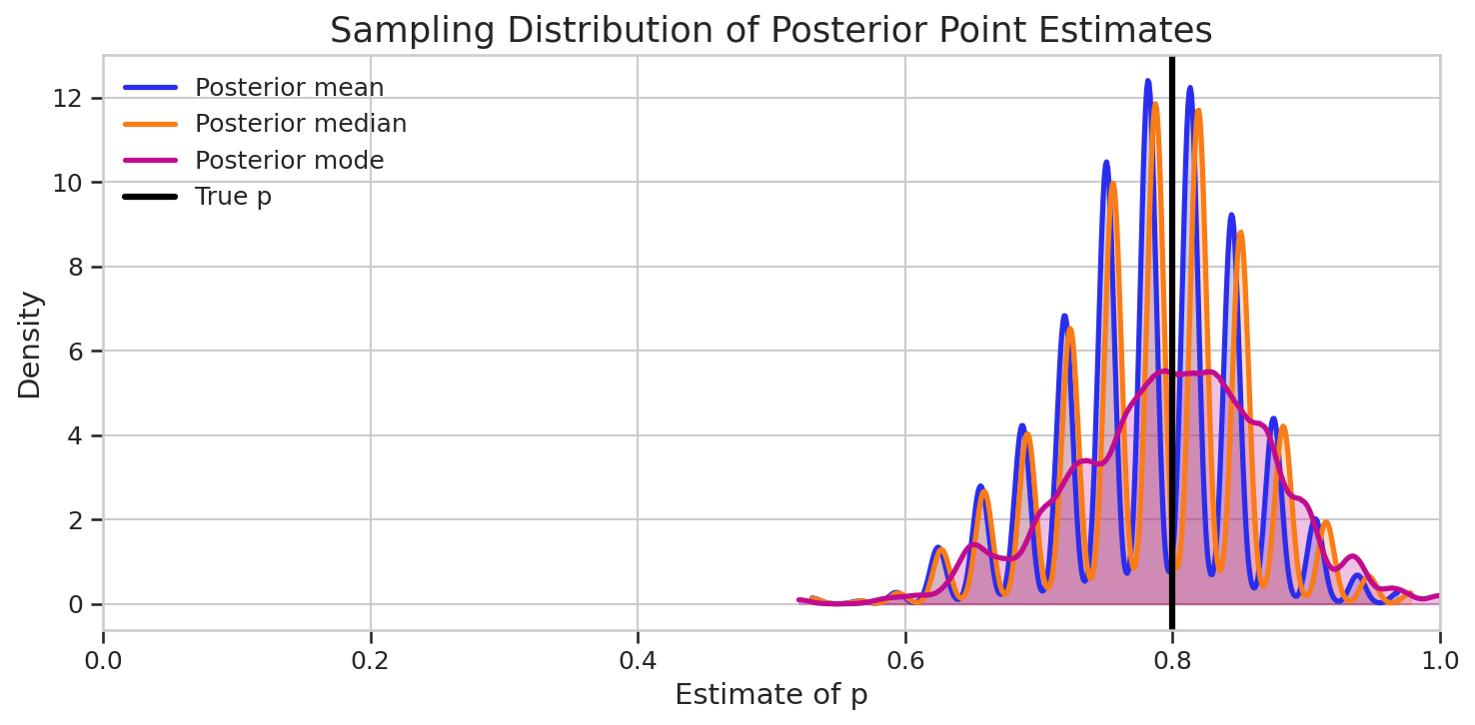
The distribution of the estimators
Across multiple simulated datsets
With the same true value of the parameter
The distributions are affected by having discrete data
We can see differences more clearly by zooming in

Slide 30
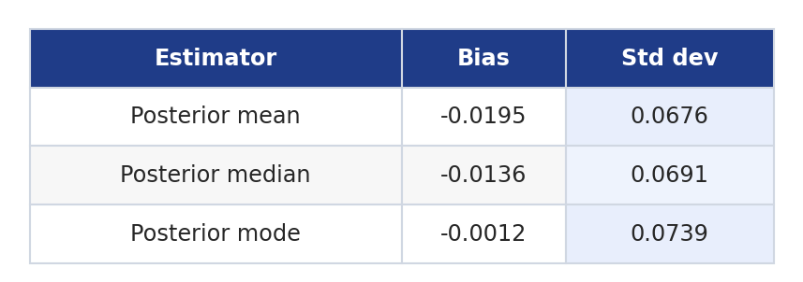
The bias / variance tradeoff
Often an estimator that is more accurate is less precise
Accurate: less bias
Precise: less variance

Slide 31
Which estimator to use
Mean
Usually preferred
Takes entire posterior into account
Best estimator for normal distributions
Many posterior distributions are close to normal
Especially with enough data
Mode
Lower bias when posterior is asymmetric
Single value with the largest probability or probability density

Slide 32
3.6 HDI
The highest density interval: definition, presentation, coverage

Slide 33
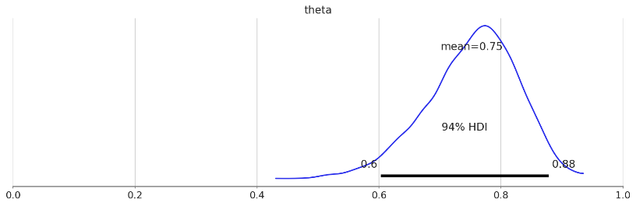

Summarizing the posterior distribution
Arviz gives mean as default estimate
Also sd : how wide is the posterior
How uncertain are we
Also HDI : the highest density interval

Slide 34
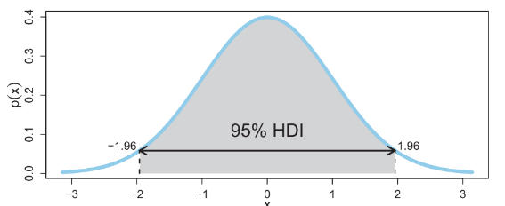
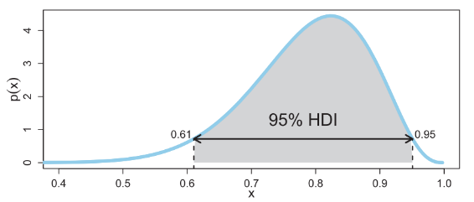
Highest density interval
An interval of largest values that contains 95% of the probability

Slide 35
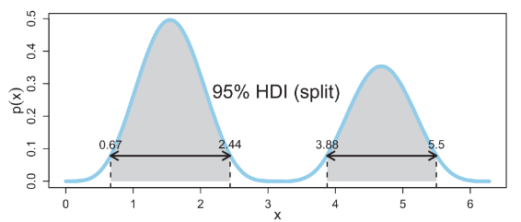
An HDI can be disconnected
An interval of largest values that contains 95% of the probability

Slide 36
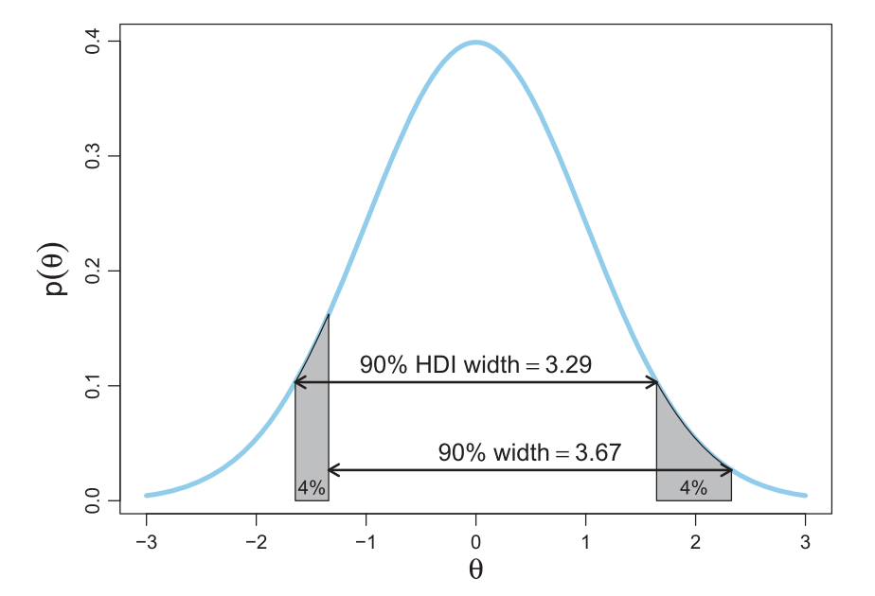
The logic of the HDI
Unimodal
Univariate
HDI is the shortest interval

Slide 37
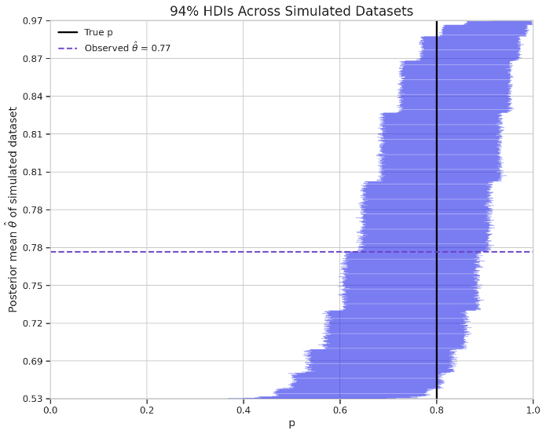
How will HDI vary across datasets
Multiple simulated datasets
With same true p=0.8
Each dataset has a different HDI
Sorted by estimate of p
mean

Slide 38
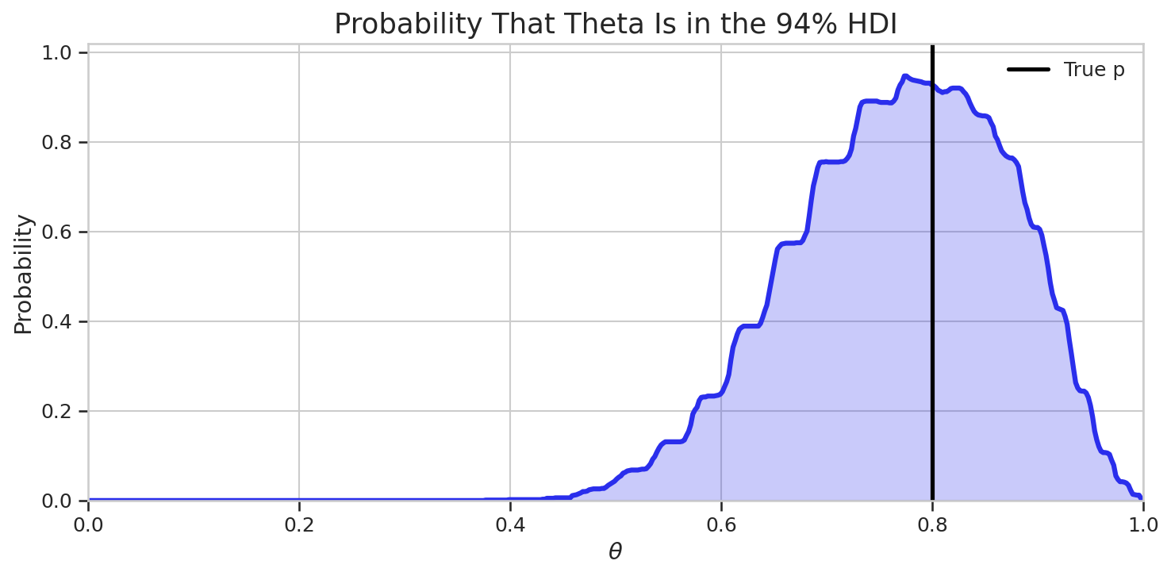
Coverage of the HDI
Coverage
How often would the HDI contain the parameter
If we repeated the experiment over and over again
This is different from the HDI probability
The probability that the HDI contains the parameter given our data and prior
An epistemic probability

Slide 39
3.7 Frequentist vs Bayesian philosophies
Data updates understanding vs data reveals truths

Slide 40
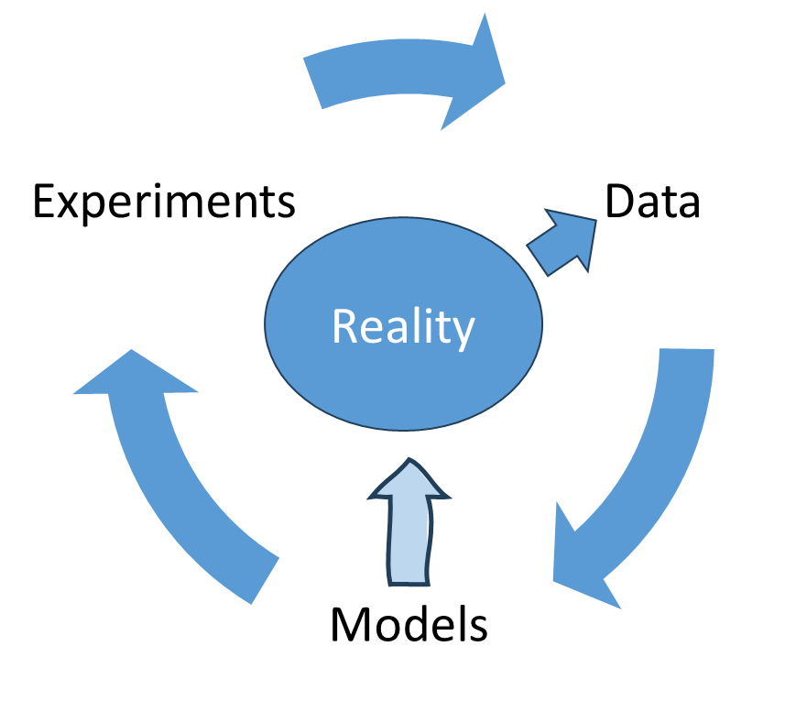
The Bayesian philosophy
Data tells us about the world
It updates our understanding
Models express our knowledge
Probability distributions over parameters express uncertainty
Bayesian updating combines knowledge with new information
Models are a convenience
They can be critiqued, replaced, or updated

Slide 41
Frequentist uncertainty is aleatory uncertainty
Frequentists want an objective, procedure-based approach
Same data + same procedure -> same answer
Probability is randomness in the data
Not the parameters
Parameter may not be treated as random variables
Frequentists focus on aleatory uncertainty
Uncertainty arises from real-world stochasticity
Running the experiment again will lead to different data
Which will lead to different estimates
So frequentists ask:
What makes a good estimator
How can we characterize estimator behavior
Across repeated experiments

Slide 42
Bayesians and frequentists ask different questions
Bayesian
Given the model and the data, what should we believe about the parameter?
Frequentist
If we repeat the procedure many times, how will the estimator behave?
This course is “Bayesian first”
Learn about frequentist methods
But understand them from a Bayesian perspective
 | Bayesian | Frequentist
Object of uncertainty | Parameters | Repeated sample behavior
Probability | Aleatory + epistemic | Aleatory
Goal of analysis | Posterior distribution | Estimator
Assessing uncertainty | Posterior distribution | Sampling interval

Slide 43
3.8 Frequentist estimation
Kinds of estimators, criteria for estimators, estimators and statistics

Slide 44
Estimators and statistics
A statistic is anything you calculate on the data
It may or may not estimate anything
An estimator is a statistic that is the guess of some real value

Slide 45
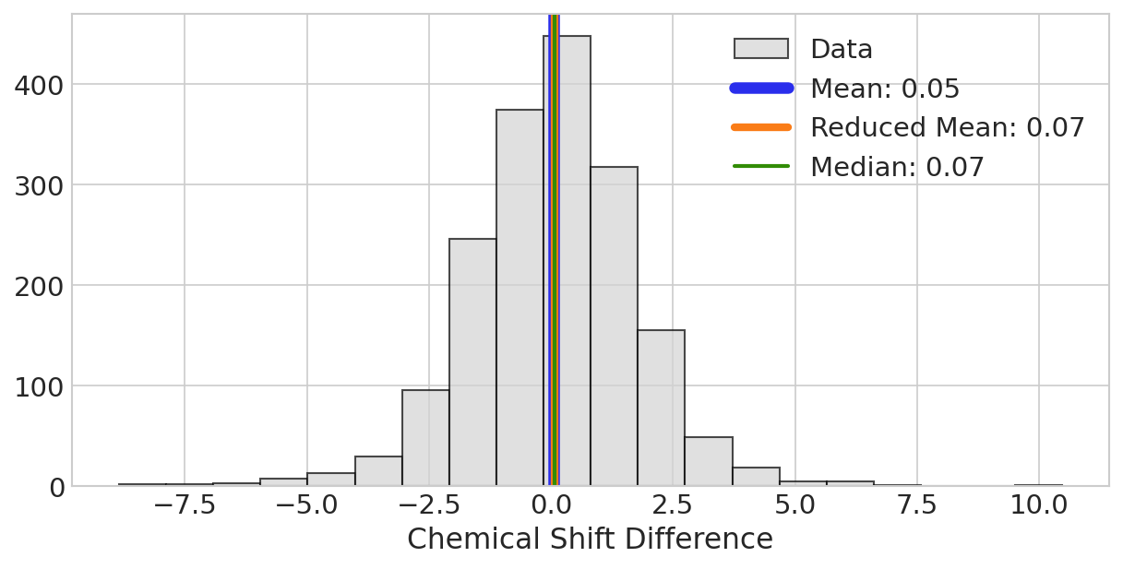
Estimators of the mean
The sample mean
The MLE and MVUE if the population is normal
Sensitive to outliers
The sample median
Variable but not sensitive to outliers
The reduced mean
A compromise
Calculate without 20% of outlying data

Slide 46
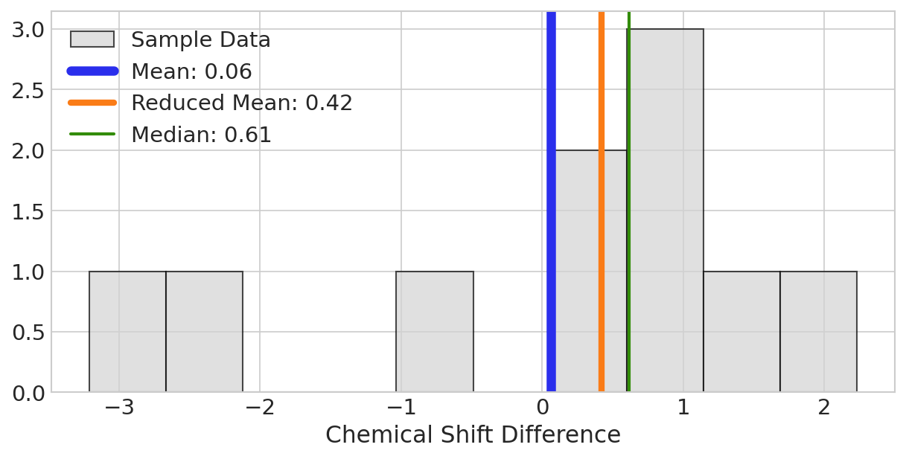
Estimation is only easy for good data
Differences become substantial for small data sets
Or with large outliers

Slide 47
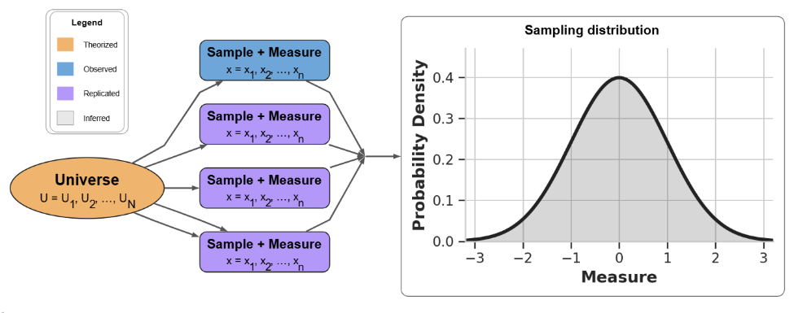
Sampling distribution of the statistic
The distribution we expect for the estimator under replications

Slide 48
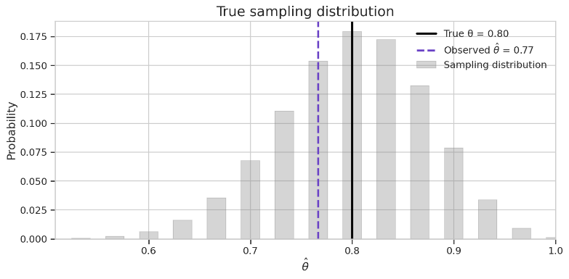
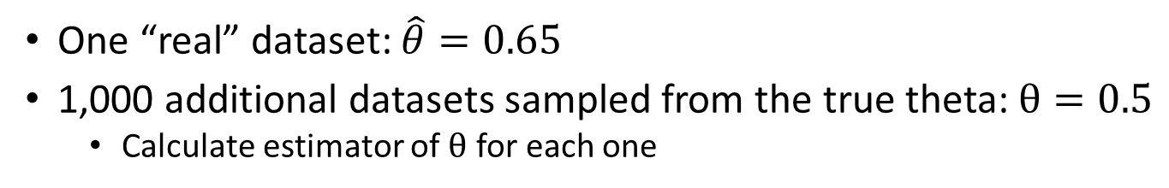
Sampling distribution for a binomial likelihood
One “real” dataset: $\hat{θ}=0.65$
1,000 additional datasets sampled from the true theta: $θ=0.5$
Calculate estimator of $θ$ for each one

Slide 49
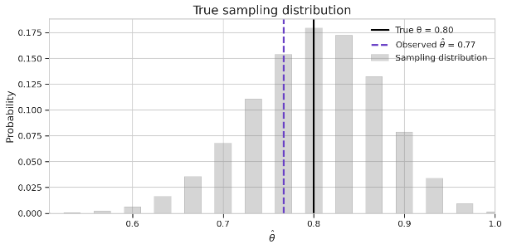
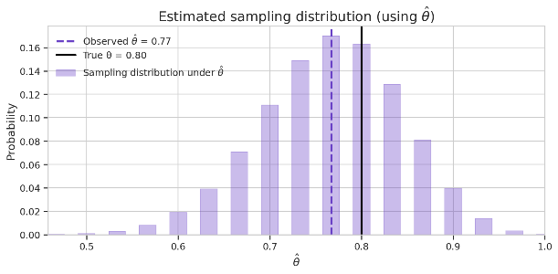
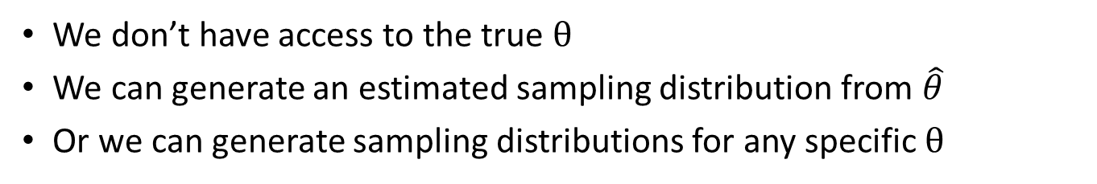
Estimated sampling distribution
We don’t have access to the true $θ$
We can generate an estimated sampling distribution from $\hat{θ}$
Or we can generate sampling distributions for any specific $θ$

Slide 50
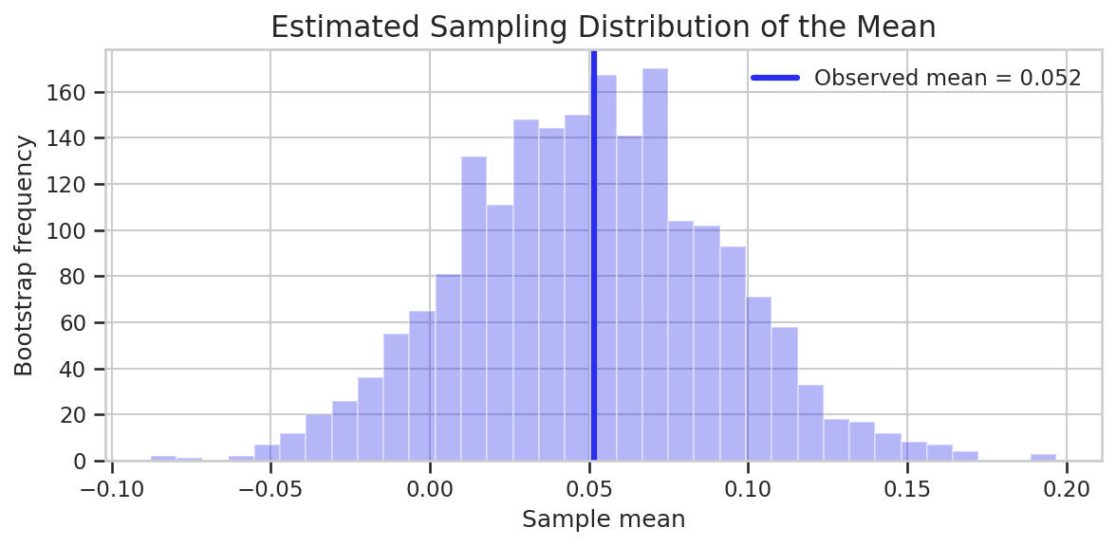
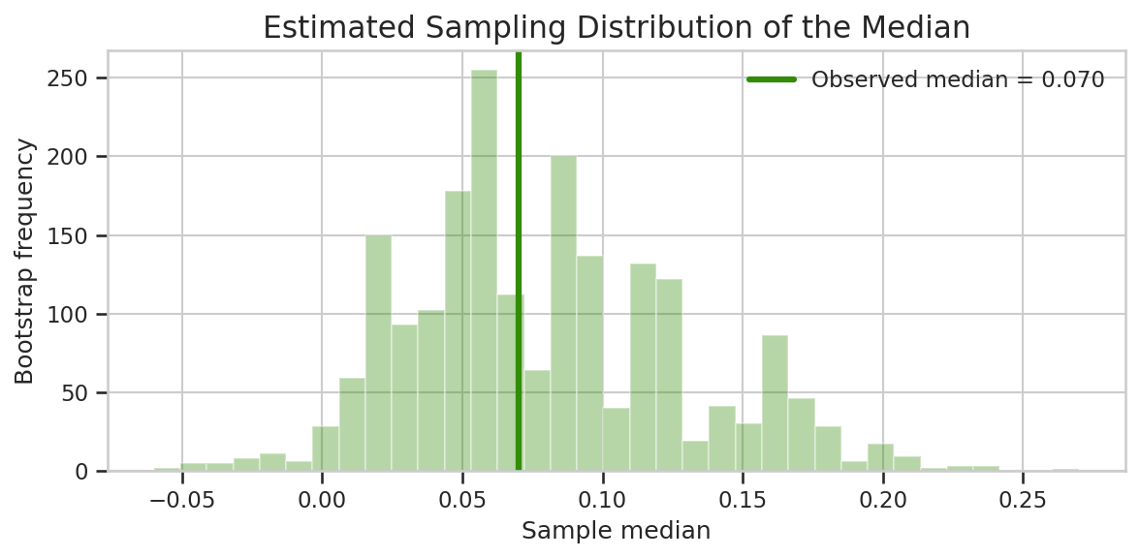
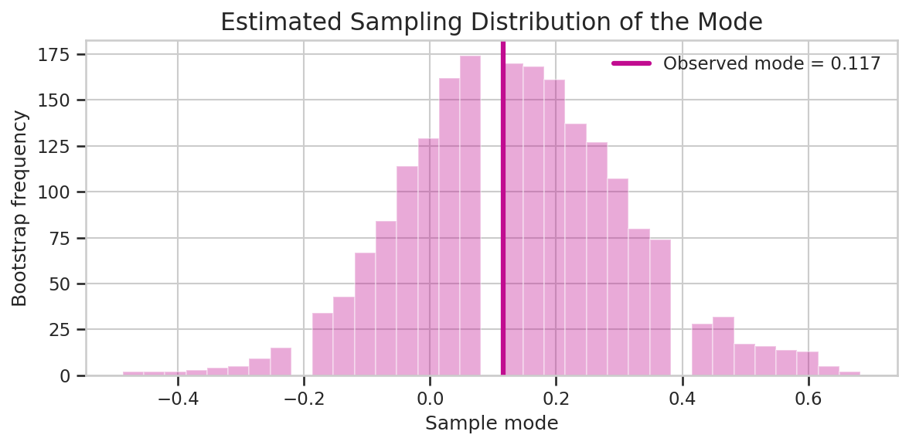
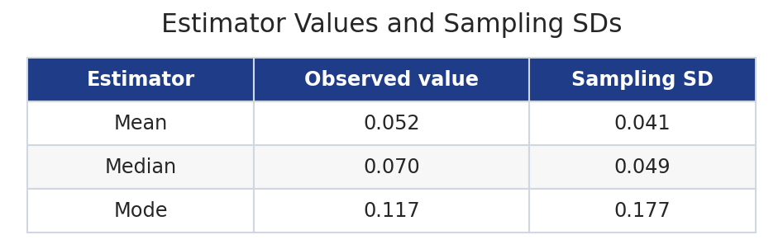
Sampling distribution for estimator uncertainty
Measure uncertainty of mean, median and mode

Slide 51
3.9 Maximum likelihood
An estimator based on a parametric model

Slide 52
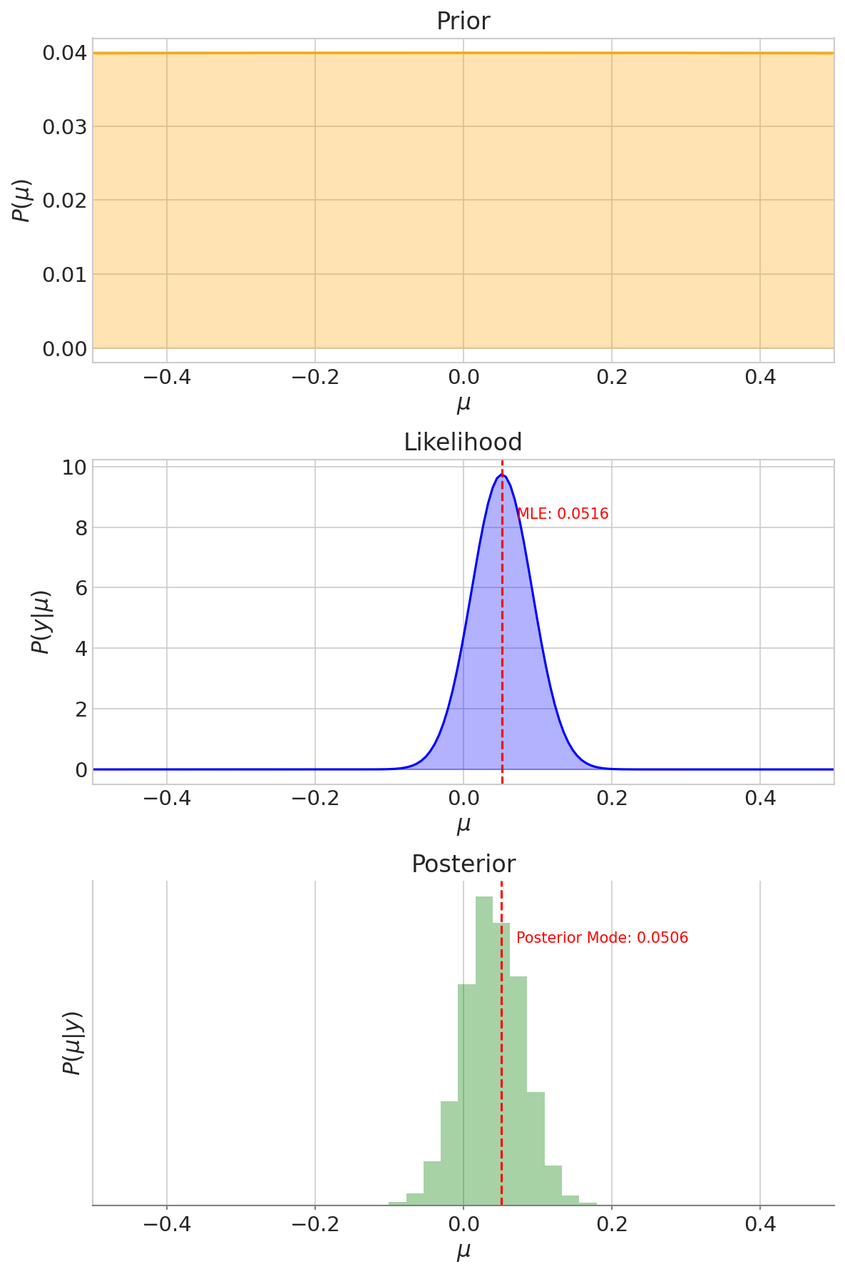
What is the MLE?
Likelihood
MLE is the maximum of the likelihood
As a function of the parameter
Requires a model
Why MLE?
The parameter that makes our data easiest to believe

Slide 53
Is the MLE a good estimator?
Advantages
Disadvantages
Consistency
Converges to the true value
Efficiency
Minimum variance
For large samples
and many practical models
Flexibility
Works with complex models
Sensitive to:
Model misspecification
Outliers
Computationally complex

Slide 54
The MLE through Bayesian eyes
We would multiply the prior by the likelihood and explore the posterior
MLE is sort of like:
Using a flat prior
So posterior = likelihood
Summarizing the posterior with an estimate
Instead of using an HDI
Or using the whole posterior
What is lost:
The full posterior uncertainty
Prior information
When is it useful
Often good as a quick estimate
For large data sets
And simpler models

Slide 55
3.10 Confidence intervals
The sampling distribution and how to use it to make a credible interval

Slide 56
The idea of the confidence interval
The sampling distribution under a parameter tells us:
What estimator values are we likely to get
Given an actual estimate we ask:
For which parameter values is this estimate typical
And for which is it unusual
The confidence interval is
The set of parameters for which this estimate is not too unusual

Slide 57
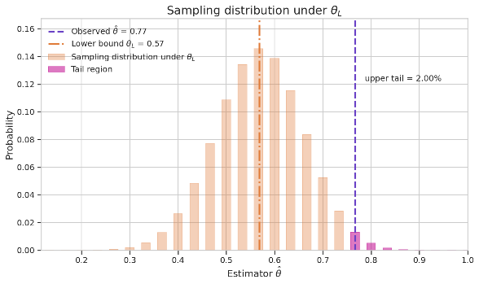


The lower tail statistic
Given some data$y^{∗}$
We can define the lower tail function
The smallest theta that has at least a 2% chance of producing data like ours
The upper tail of the sampling distribution of $θ_{L}$ is the observed data

Slide 58



$θ_{L}$ and $θ_{U}$ are the upper and lower tail statistics
Intuitively the highest and lowest $θ$ for which the data make sense

Slide 59



$θ_{L}$ and $θ_{U}$ have sampling distributions!
So we can calculate the probability that $θ_{L}≤θ≤θ_{U}$
It is 98%

Slide 60

Definition of the confidence interval
If we can define two functions: $L\left(y^{∗}\right)$ and $H\left(y^{∗}\right)$
Of any dataset $y^{∗}$
Such that $p\left(L\left(y^{∗}\right)≤θ≤H\left(y^{∗}\right)\right)=0.96$
The probability is over different datasets
Equality holds no matter what the true $θ$
Then:
Given a real dataset $y$
The interval $\left[L\left(y\right), H\left(y\right)\right]$ is the 96% confidence interval

Slide 61

Defining a confidence interval (in steps)
Choose functions $L\left(y^{∗}\right)$ and $H\left(y^{∗}\right)$
Prove that they have coverage:
$p\left(L\left(y^{∗}\right)≤θ≤H\left(y^{∗}\right)\right)=0.96$
Regardless of the $θ$
Now for actual data $y$:
Calculate $\left[L\left(y\right), H\left(y\right)\right]$
You have your confidence interval!!
Theory
Calculation

Slide 62

Confidence interval defined on actual data
But defined only if sampling distribution fits the definition

Slide 63


More than one confidence interval
Different methods with different assumptions

Slide 64

Bayesian and frequentist interval estimates
Both represent probability statements
HDI
Probability statement about the parameter
What do we know about it given data and priors
CI
Probability statement about the data
For which parameters is this data unlikely?

Slide 65
Misinterpretations of CI in literature
Ascribing probability to a parameter is misusing the CI
“There’s a 95% chance the true parameter is in this interval.”
“This CI tells me where the parameter is most likely to be.”
“This CI means the null model is likely / unlikely.”
The correct way to say it:
“If the experiment is repeated many times, there is a 95% chance the CI will contain the parameter”

Slide 66
3.11 Next time
MCMC: how does sampling actually work?

Slide 67


Posterior distributions are often hard to sample
No closed form random number generator
Need an algorithm that ‘matches probability’
An algorithm that goes from place to place like a king in a boat
An algorithm that flies around in space like a sattelite

